Slide 1
Lecture-02: Bubble, insertion and selection sort
Tanvir Ahammad
Lecturer, JnU
Notes:
‹#›

Slide 2
Sorting
Sorting: Transforms an unordered collection into an ordered one.
1 2 3 4 5 6
77
42
35
12
101
5
1 2 3 4 5 6
5
12
35
42
77
101
Notes:
‹#›

Slide 3
Why is sorting important?
Sorting collections enables efficient search
For example: Phone Book
Sorted by Last Name (“lots” of work to do this)
Easy to look someone up if you know their last name
Tedious (but straightforward) to find by First name or Address
Important if data will be searched many times
Notes:
‹#›

Slide 4
Bubble sort

Slide 5
"Bubbling Up" the Largest Element
The algorithm gets its name from the way smaller elements "bubble" to the top of the list.
Traverse a collection of elements
Move from the front to the end
“Bubble” the largest value to the end using pair-wise comparisons and swapping
1 2 3 4 5 6
77
42
35
12
101
5
Notes:
‹#›

Slide 6
"Bubbling Up" the Largest Element
Traverse a collection of elements
Move from the front to the end
“Bubble” the largest value to the end using pair-wise comparisons and swapping
Swap
1 2 3 4 5 6
42
77
77
42
35
12
101
5
Notes:
‹#›

Slide 7
"Bubbling Up" the Largest Element
Traverse a collection of elements
Move from the front to the end
“Bubble” the largest value to the end using pair-wise comparisons and swapping
1 2 3 4 5 6
Swap
35
77
42
77
35
12
101
5
Notes:
‹#›

Slide 8
"Bubbling Up" the Largest Element
Traverse a collection of elements
Move from the front to the end
“Bubble” the largest value to the end using pair-wise comparisons and swapping
1 2 3 4 5 6
Swap
12
77
42
35
77
12
101
5
Notes:
‹#›

Slide 9
"Bubbling Up" the Largest Element
Traverse a collection of elements
Move from the front to the end
“Bubble” the largest value to the end using pair-wise comparisons and swapping
1 2 3 4 5 6
42
35
12
77
101
5
No need to swap
Notes:
‹#›

Slide 10
"Bubbling Up" the Largest Element
Traverse a collection of elements
Move from the front to the end
“Bubble” the largest value to the end using pair-wise comparisons and swapping
1 2 3 4 5 6
Swap
5
101
42
35
12
77
101
5
Notes:
‹#›

Slide 11
"Bubbling Up" the Largest Element
Traverse a collection of elements
Move from the front to the end
“Bubble” the largest value to the end using pair-wise comparisons and swapping
1 2 3 4 5 6
101
42
35
12
77
5
Largest value correctly placed
Notes:
‹#›

Slide 12
Items of Interest
Notice that only the largest value is correctly placed
All other values are still out of order
So we need to repeat this process
1 2 3 4 5 6
101
42
35
12
77
5
Largest value correctly placed
Notes:
‹#›

Slide 13
Repeat “Bubble Up” How Many Times Many?
If we have N elements…
And if each time we bubble an element, we place it in its correct location…
Then we repeat the “bubble up” process N – 1 times.
This guarantees we’ll correctly place all N elements.
Notes:
‹#›

Slide 14
Example: Bubble Sort
Let us take the array of numbers "5, 1, 4, 2, 8", and sort the array from lowest number to greatest number using bubble sort. In each step, elements written in bold are being compared

Slide 15
Example: Bubble Sort (cont…)
Pass 1:
( 5 1 4 2 8 ) -> ( 1 5 4 2 8 ): compares the first two elements, and swaps since 5 > 1
( 1 5 4 2 8 ) -> ( 1 4 5 2 8 ), Swap since 5 > 4
( 1 4 5 2 8 ) -> ( 1 4 2 5 8 ), Swap since 5 > 2
( 1 4 2 5 8 ) ->( 1 4 2 5 8 ), Now, since these elements are already in order (8 > 5), algorithm does not swap them.

Slide 16
Example: Bubble Sort (cont…)
Pass 2:
( 1 4 2 5 8 ) -> ( 1 4 2 5 8 )
( 1 4 2 5 8 ) -> ( 1 2 4 5 8 ), Swap since 4 > 2
( 1 2 4 5 8 ) -> ( 1 2 4 5 8 )

Slide 17
Example: Bubble Sort (cont…)
Pass 3:
( 1 2 4 5 8 ) -> ( 1 2 4 5 8 ); no swap
( 1 2 4 5 8 ) -> to ( 1 2 4 5 8 ); no swap

Slide 18
Example: Bubble Sort (cont…)
Pass 4:
( 1 2 4 5 8 ) -> ( 1 2 4 5 8 ); no swap
After Bubble Sort: 1, 2, 4, 5, 8

Slide 19
Example-2: Bubble Sort
Try it for: 32, 51, 27, 85, 66, 23, 13, 57
How many pass?

Slide 20
Example-2: Bubble Sort
Pass 1:
32 51 27 85 66 23 13 57
32 27 51 85 66 23 13 57
32 27 51 85 66 23 13 57
32 27 51 66 85 23 13 57
32 27 51 66 23 85 13 57
32 27 51 66 23 13 85 57
32 27 51 66 23 13 57 85

Slide 21
Example-2: Bubble Sort
Pass 2:
27 32 51 66 23 13 57 85
27 32 51 66 23 13 57 85
27 32 51 66 23 13 57 85
27 32 51 23 66 13 57 85
27 32 51 23 13 66 57 85
27 32 51 23 13 57 66 85

Slide 22
Example-2: Bubble Sort
Pass 3:
27 32 51 23 13 57 66 85
27 32 51 23 13 57 66 85
27 32 23 51 13 57 66 85
27 32 23 13 51 57 66 85
27 32 23 13 51 57 66 85

Slide 23
Example-2: Bubble Sort
Pass 4:
27 32 23 13 51 57 66 85
27 23 32 13 51 57 66 85
27 23 13 32 51 57 66 85
27 23 13 32 51 57 66 85

Slide 24
Example-2: Bubble Sort
Pass 5:
23 27 13 32 51 57 66 85
23 13 27 32 51 57 66 85
23 13 27 32 51 57 66 85

Slide 25
Example-2: Bubble Sort
Pass 6:
13 23 27 32 51 57 66 85
13 23 27 32 51 57 66 85

Slide 26
Example-2: Bubble Sort
Pass 7:
13 23 27 32 51 57 66 85
After Bubble Sort: 13, 23, 27, 32, 51, 57, 66, 85

Slide 27
Exercise: Bubble Sort
Consider 6 letters: P E O P L E
Now sort it using Bubble sort approach in alphabetically.

Slide 28
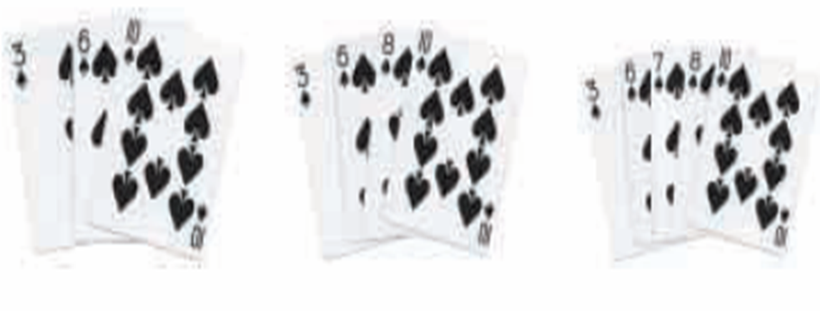
Insertion Sort
Insertion sort is an elementary sorting algorithm that sorts one element at a time, i.e., takes an element from the list and places it in the correct location in the list; repeated until there are no more unsorted items in the list.

Slide 29

Example: Insertion sort Sort
Notes:
‹#›

Slide 30
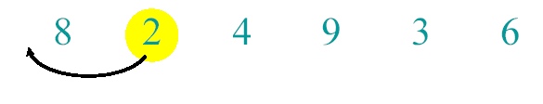
Example of Insertion Sort
Notes:
‹#›

Slide 31
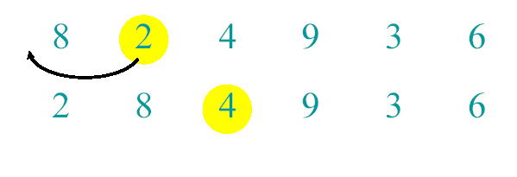
Example of Insertion Sort
Notes:
‹#›

Slide 32
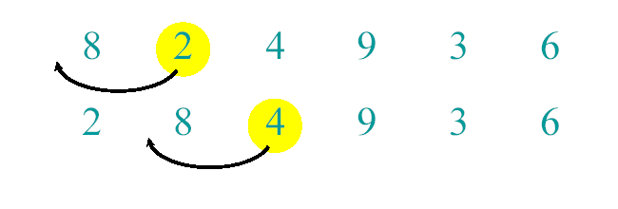
Example of Insertion Sort
Notes:
‹#›

Slide 33
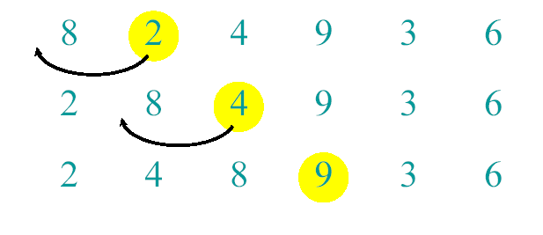
Example of Insertion Sort
Notes:
‹#›

Slide 34
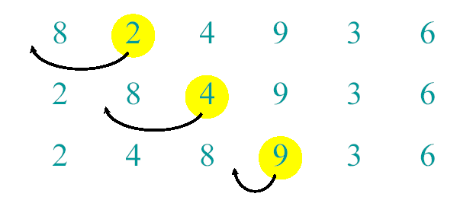
Example of Insertion Sort
Notes:
‹#›

Slide 35
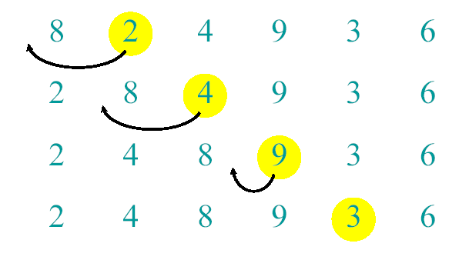
Example of Insertion Sort
Notes:
‹#›

Slide 36
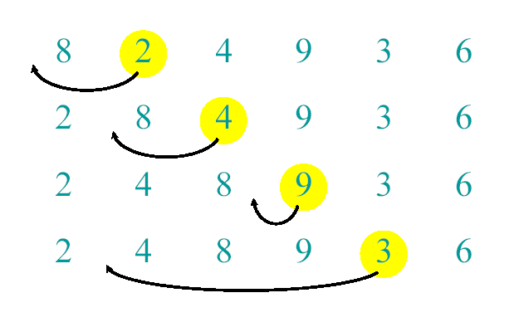
Example of Insertion Sort
Notes:
‹#›

Slide 37
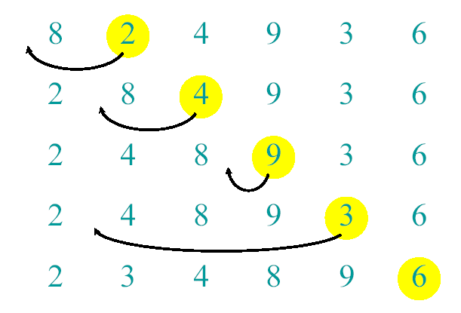
Example of Insertion Sort
Notes:
‹#›

Slide 38
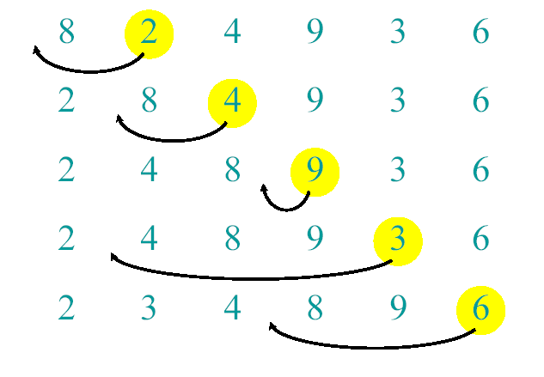
Example of Insertion Sort
Notes:
‹#›

Slide 39
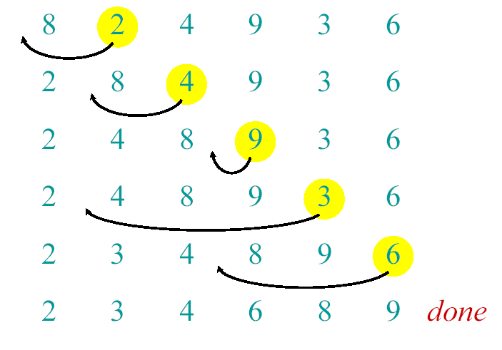
Example of Insertion Sort
Notes:
‹#›

Slide 40
Algorithm
InsertionSort(A, n) { for i = 2 to n { key = A[i] j = i - 1; while (j > 0) and (A[j] > key) { A[j+1] = A[j] j = j - 1 } A[j+1] = key }
}

Slide 41
Exercise: Insertion Sort
Array: 77, 33, 44, 11, 88, 22, 66, 55

Slide 42
Exercise: Insertion Sort
Array: 77, 33, 44, 11, 88, 22, 66, 55
Step 1: 33 77 44 11 88 22 66 55
Step 2: 33 44 77 11 88 22 66 55
Step 3: 11 33 44 77 88 22 66 55
Step 4: 11 33 44 77 88 22 66 55
Step 5: 11 22 33 44 77 88 66 55
Step 6: 11 22 33 44 66 77 88 55
Step 7: 11 22 33 44 55 66 77 88
After Insertion Sort:
11 22 33 44 55 66 77 88

Slide 43
Selection Sort
One of the simplest sorting algorithm that works as follows:
Find the minimum value in the list.
Swap it with the value in the first position.
Repeat the steps above for the remainder of the list.

Slide 44
Example: Selection Sort
One of the simplest sorting algorithm that works as follows:
Find the minimum value in the list.
Swap it with the value in the first position.
Repeat the steps above for the remainder of the list.

Slide 45
Example: Selection Sort
77 | 33 | 44 | 11 | 88 | 22
Comparison
Data Movement
Sorted

Slide 46
Selection Sort
77 | 33 | 44 | 11 | 88 | 22
Comparison
Data Movement
Sorted

Slide 47
Selection Sort
77 | 33 | 44 | 11 | 88 | 22
Comparison
Data Movement
Sorted

Slide 48
Selection Sort
77 | 33 | 44 | 11 | 88 | 22
Comparison
Data Movement
Sorted

Slide 49
Selection Sort
77 | 33 | 44 | 11 | 88 | 22
Comparison
Data Movement
Sorted

Slide 50
Selection Sort
77 | 33 | 44 | 11 | 88 | 22
Comparison
Data Movement
Sorted

Slide 51
Selection Sort
77 | 33 | 44 | 11 | 88 | 22
Comparison
Data Movement
Sorted

Slide 52
Selection Sort
77 | 33 | 44 | 11 | 88 | 22
🠅Smallest
Comparison
Data Movement
Sorted

Slide 53
Selection Sort
11 | 33 | 44 | 77 | 88 | 22
Comparison
Data Movement
Sorted

Slide 54
Selection Sort
11 | 33 | 44 | 77 | 88 | 22
Comparison
Data Movement
Sorted

Slide 55
Selection Sort
11 | 33 | 44 | 77 | 88 | 22
Comparison
Data Movement
Sorted

Slide 56
Selection Sort
11 | 33 | 44 | 77 | 88 | 22
Comparison
Data Movement
Sorted

Slide 57
Selection Sort
11 | 33 | 44 | 77 | 88 | 22
Comparison
Data Movement
Sorted

Slide 58
Selection Sort
11 | 33 | 44 | 77 | 88 | 22
Comparison
Data Movement
Sorted

Slide 59
Selection Sort
11 | 33 | 44 | 77 | 88 | 22
🠅Smallest
Comparison
Data Movement
Sorted

Slide 60
Selection Sort
11 | 33 | 44 | 77 | 88 | 22
Comparison
Data Movement
Sorted

Slide 61
Selection Sort
11 | 22 | 44 | 77 | 88 | 33
Comparison
Data Movement
Sorted

Slide 62
Selection Sort
11 | 22 | 44 | 77 | 88 | 33
Comparison
Data Movement
Sorted

Slide 63
Selection Sort
11 | 22 | 44 | 77 | 88 | 33
Comparison
Data Movement
Sorted

Slide 64
Selection Sort
11 | 22 | 44 | 77 | 88 | 33
Comparison
Data Movement
Sorted

Slide 65
Selection Sort
11 | 22 | 44 | 77 | 88 | 33
🠅Smallest
Comparison
Data Movement
Sorted

Slide 66
Selection Sort
11 | 22 | 44 | 77 | 88 | 33
Comparison
Data Movement
Sorted

Slide 67
Selection Sort
11 | 22 | 33 | 77 | 88 | 44
Comparison
Data Movement
Sorted

Slide 68
Selection Sort
11 | 22 | 33 | 77 | 88 | 44
Comparison
Data Movement
Sorted

Slide 69
Selection Sort
11 | 22 | 33 | 77 | 88 | 44
Comparison
Data Movement
Sorted

Slide 70
Selection Sort
11 | 22 | 33 | 77 | 88 | 44
🠅Smallest
Comparison
Data Movement
Sorted

Slide 71
Selection Sort
11 | 22 | 33 | 44 | 88 | 77
Comparison
Data Movement
Sorted

Slide 72
Selection Sort
11 | 22 | 33 | 44 | 88 | 77
Comparison
Data Movement
Sorted

Slide 73
Selection Sort
11 | 22 | 33 | 44 | 88 | 77
🠅Smallest
Comparison
Data Movement
Sorted

Slide 74
Selection Sort
11 | 22 | 33 | 44 | 77 | 88
Comparison
Data Movement
Sorted

Slide 75
Selection Sort
11 | 22 | 33 | 44 | 77 | 88
Comparison
Data Movement
Sorted

Slide 76
Selection Sort
11 | 22 | 33 | 44 | 77 | 88
DONE!
Comparison
Data Movement
Sorted

Slide 77
Example
Sort numbers using Selection sort algorithm:
77 33 44 11 88 22 66 55

Slide 78
Example: cont…
Array: 77 33 44 11 88 22 66 55
Step 1 : 11 33 44 77 88 22 66 55
Step 2: 11 22 44 77 88 33 66 55
Step 3: 11 22 33 77 88 44 66 55
Step 4: 11 22 33 44 88 77 66 55
Step 5: 11 22 33 44 55 77 66 88
Step 6: 11 22 33 44 55 66 77 88
Step 7: 11 22 33 44 55 66 77 88
After sorting:
11 22 33 44 55 66 77 88

Slide 79
Algorithm
SELECTIONSORT(A,N)
1. for i=1 to N-1
2. min= i
3. for j=i+1 to N
4. if A[j]<A[min]
5. min=j
6. exchange A[i] and A[min]

